Slide 1
Getting SPICY with SQL
A crash course on SQL by KEVIN ZHANG

Slide 2
TODAY’S AGENDA
Introduction to SQL
A brief history lesson and its practical uses
Tables and the relational database model
The bread and butter
SELECT, INSERT, CREATE, DROP, DELETE, and UPDATE statements
The tricky stuff
JOIN and views
The smarty-pants stuff
SQL injection
A (cool?) project
You won’t BELIEVE what happens next, don’t click away

Slide 3
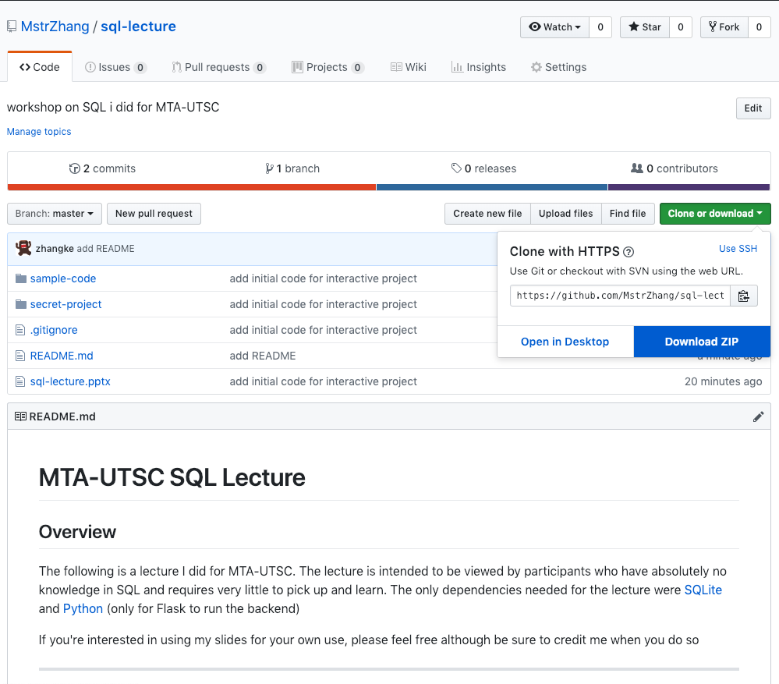
FOLLOWING ALONG?
Starter code:
Head to https://github.com/mstrzhang/sql-lecture to download slides and starter code to follow along
Click on Clone or Download and in the pop-up select the Download ZIP option
SQLite:
Head to https://sqlitebrowser.org/ to download the SQLite browser
Follow the instructions for installation on whatever operating system you’re running
Python:
You only need this if you’re following along with the “secret project”
We will be using Python 3.7

Slide 4
LET’S JUMP INTO IT…

Slide 5
A QUICK (but hopefully not too boring) HISTORY OF SQL
In the past, there were files
Crummy way of storing and retrieving data
Edgar F. Codd creates the relational model
Computer scientists from IBM create the first version of SQL that will become what we use today
And the rest is history…

Slide 6

WHAT THE HECK IS SQL?
WITH T AS (SELECT TOP 50 * FROM life ORDER BY id DESC) DELETE FROM T
SQL = Structured Query Language
A simple and organized way of inserting and retrieving information from a database
Common queries:
SELECT
INSERT
UPDATE
DELETE
CREATE
DROP

Slide 7
WHY SHOULD I LEARN THIS MUMBO JUMBO?
The average SQL Developer in the United States makes $84,245 per year
Incredibly crucial and important job in many tech companies
One of the most sought-after skills by hiring employers
Currently hundreds of thousands of open positions on Indeed.com
Essential to know for any sort of serious application development
Tons of potential jobs:
Project managers, Data analysts, Data scientists, Data engineers, …

Slide 8

WHAT CAN YOU EVEN DO WITH SQL?

